Slide 1
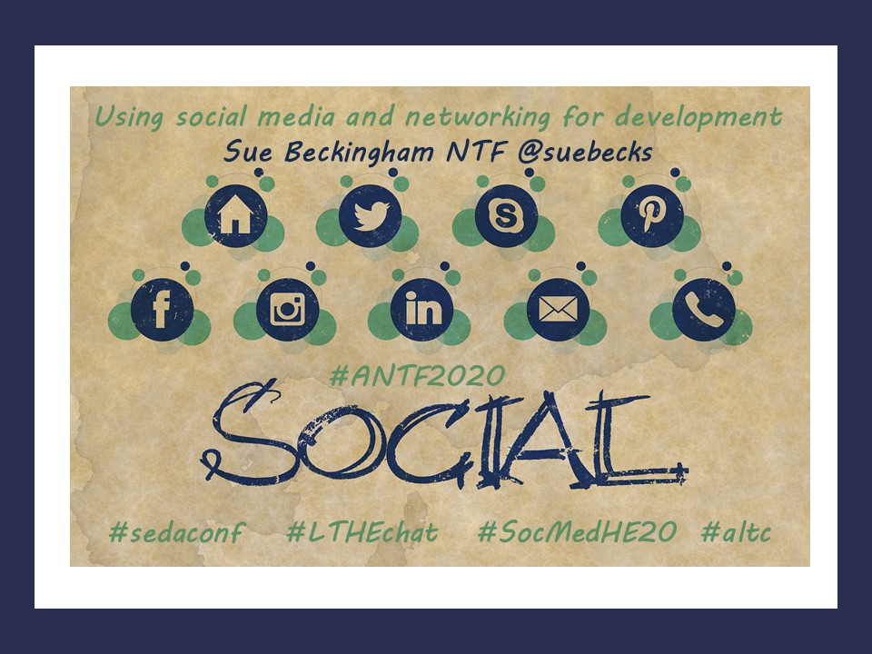

Slide 2
Using social media and networking for development
Sue Beckingham NTF @suebecks
I have been interested in how mobile technology and social media has provided new ways to learn, interact and collaborate for many years now; and how this has enabled both myself, peers and students to connect and communicate both synchronously and asynchronously. Social media for me complements the more traditional modes of communication such as email, telephone and staff intranets (and other online information repositories). Over time I have developed a digital toolbox which continues to help me to extend my professional network by connecting and reconnecting with professionals in and beyond my field. This post shares examples of some of the tools I use frequently and how they have contributed to my own development and opened opportunities to share my own work.
Twitter: This is my go-to place every day and I am guaranteed to learn something useful. I use the lists function to group people or organisations I follow together. Using Tweetdeck or Hootsuite, I can then zoom into the tweets from a specific group or hashtag, for example the weekly #LTHEchat (Learning and Teaching in Higher Education tweetchat). I now have a rich source of educators I follow who openly share their work and that of others, engage in dialogue and feedback on anything I choose to share.
Skype: Video chat is the next best thing to face to face meetings as it enables both one to one and group conversations, along with those helpful visual cues missed in telephone conference call type meetings. Being able to see each other helps to create a more relaxed meeting.
Pinterest: I find this a useful way to curate articles, infographics and videos into themed collections. You can create different virtual pin boards and pin the images to your chosen board. I find it easier to relocate items by the visual pinned.
Facebook: Whilst predominantly a ‘social’ network where I interact with family and close friends, I also follow news pages that relate to my interests and am a member of closed discussion groups e.g. Women in Academia Support Network and the BCSWomen Lovelace Colloquium Alumni.
Instagram: I enjoy seeing images shared by my peer’s, and often these give an insight into shared interests, be this our pets, music, food or books we are reading. My posts are largely photos of my dogs, garden or home cooking.
LinkedIn: This space is way more than just a digital space for your CV. It has a sophisticated search engine allowing me to find other educators in my field. Similarly others have found my profile and because I openly share presentations, links to new blog posts and research I have published, it has led to national and international invitations to speak.

