Slide 1



National Teaching Fellows Association Conference
Taking the Next Step
Date: 6th March 2020
Tessa Harrison
Partner (Education)

Slide 2


Slide 3
Session Content
﻿
What is the PVC Role in HE?
Senior Team Responsibilities
Career Planning : Taking the Next Step
Working with Executive Search

Slide 4
What is the PVC role in HE?
An outline of the purpose of PVC roles in HE
whole of institution leadership
skill set
leading without levers
impact

Slide 5
Senior Team Responsibilities
Strategy
Culture change
Politics
Partnership
Echo chamber
Personal reflections

Slide 6
Career Planning : Taking the Next Step
﻿
Why?
What sort of leader are you : personal leadership narrative?
Leadership development and coaching
Letting go
Resilience

Slide 7
Working with Executive Search
Executive Search involvement in recruitment
Getting known
Diversifying leadership teams

Slide 8

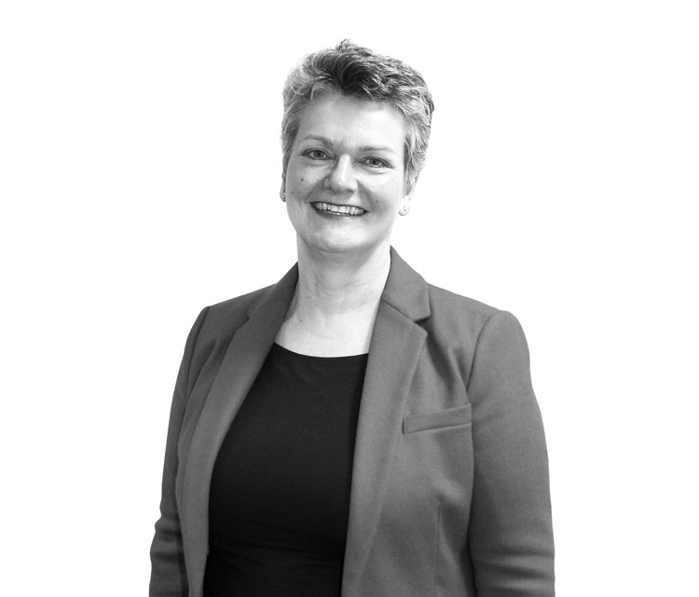
Any Questions
Tessa Harrison
Partner, Education
tessa.harrison@gatenbysanderson.com
07341 773818

