Slide 1

ANTF Symposium 2024
23rd-24th April 2024: Nottingham Trent University
The Incredible Journey: empowering potential NTF and CATE applicants via visual journey mapping
Julia Reeve
Play to Connect
julia@playtoconnect.co.uk
https://www.playtoconnect.co.uk/
https://www.linkedin.com/in/juliareeveplay/

Slide 2
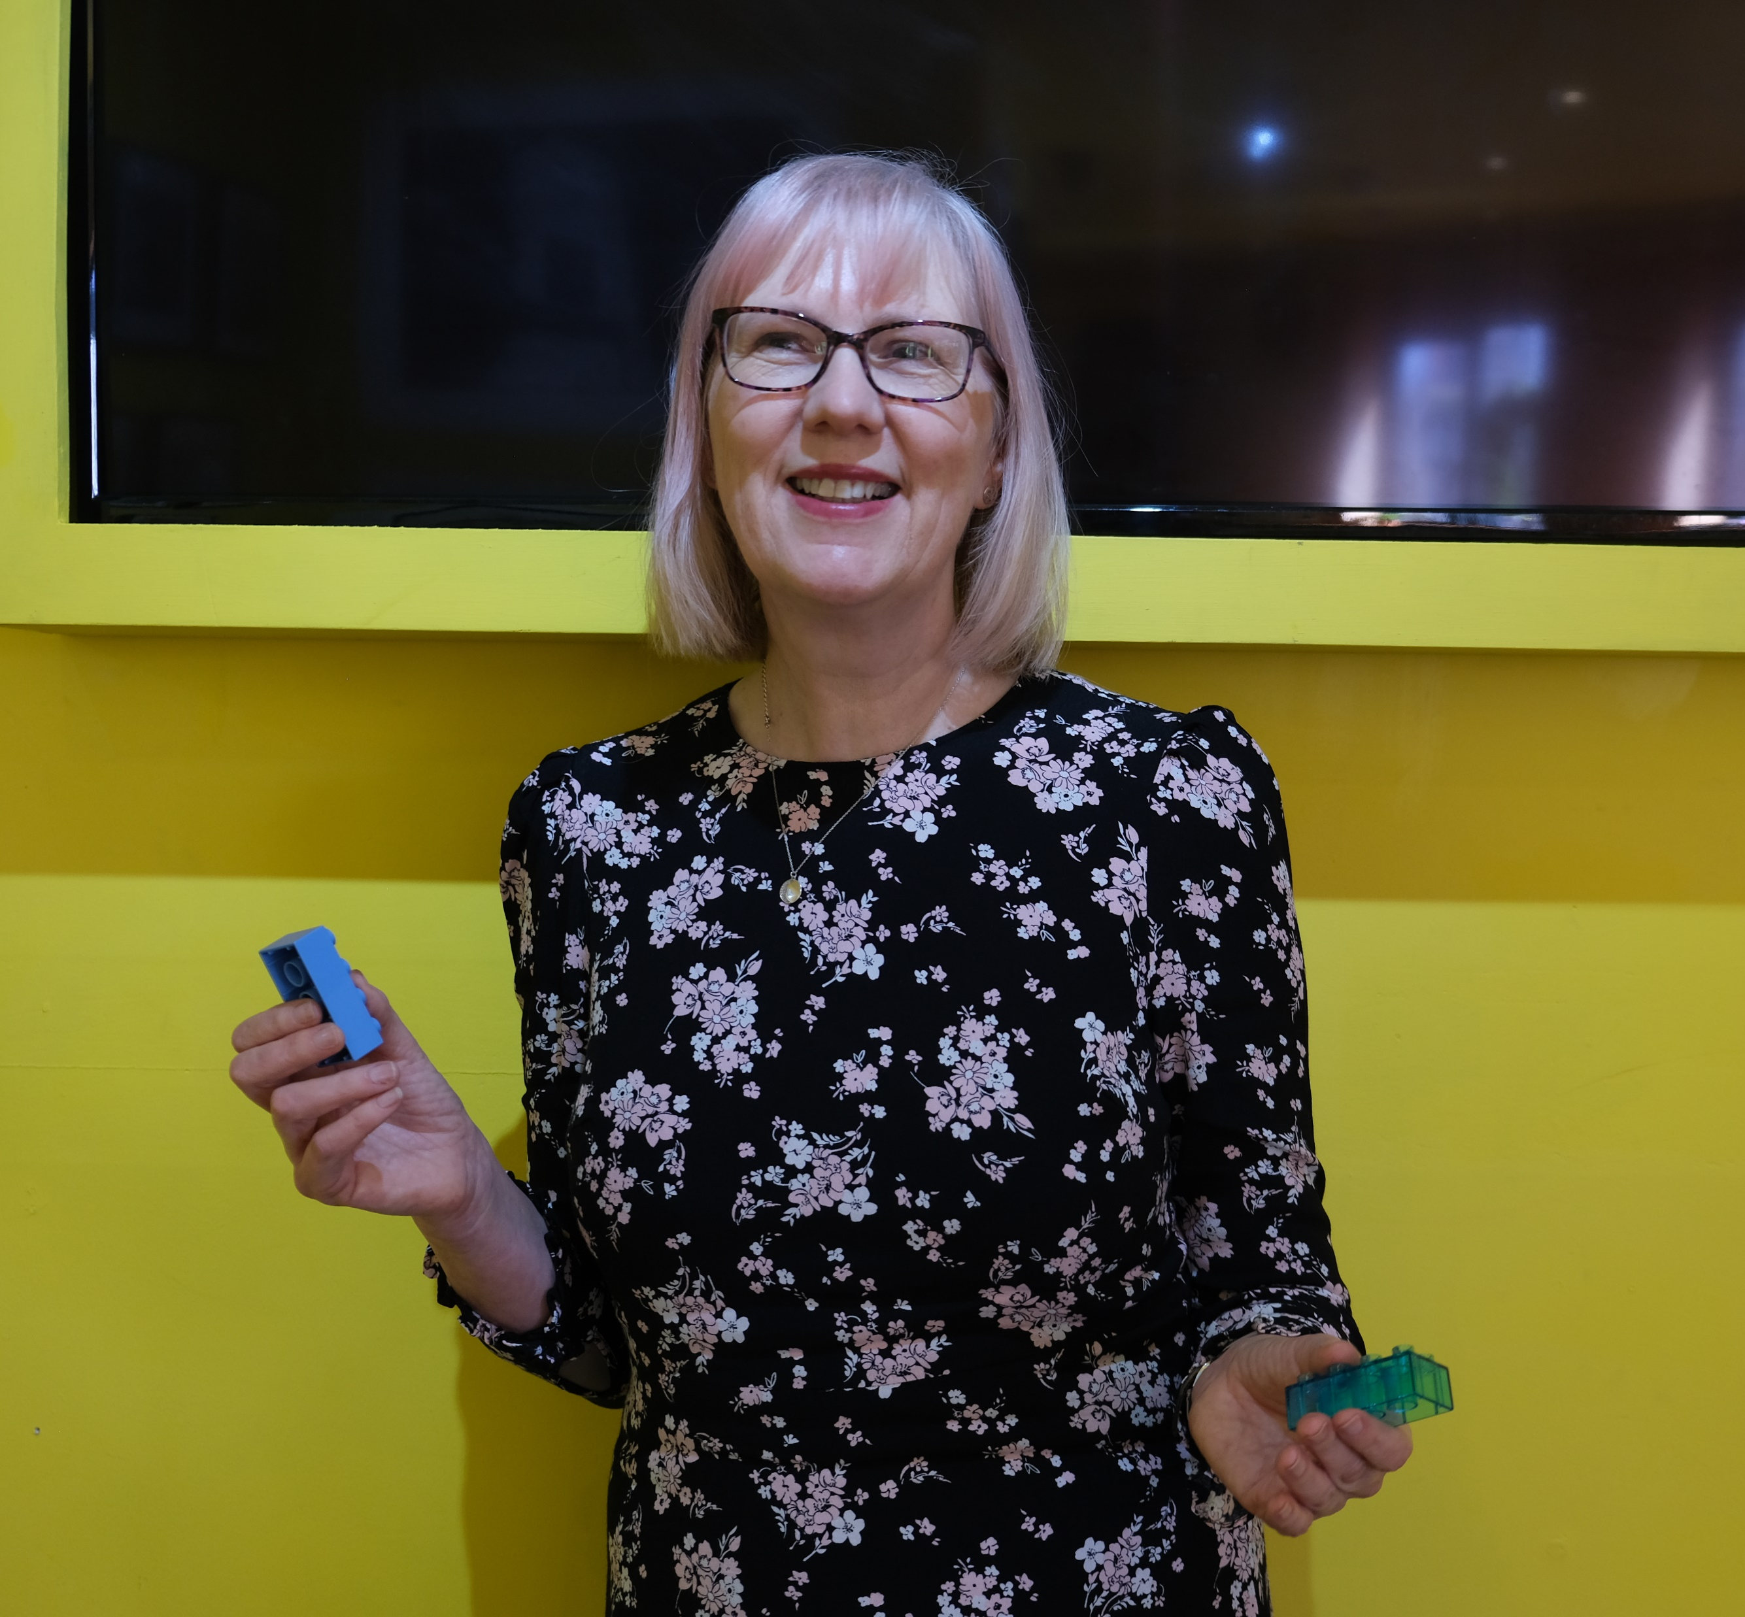
About me
Fashion design background
Industry, FE & HE, prison learning
Professional services NTF
Passionate about inclusion
Social & emotional learning, wellbeing
Multisensory, playful learning

Slide 3
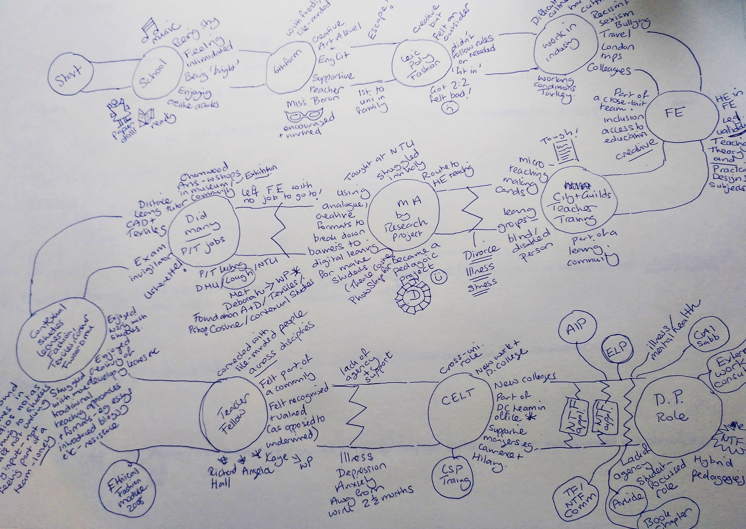
A playful approach to self-reflection and visualising future career paths
Playful, multisensory tools can provide powerful vehicles for self-awareness
Clarification of pedagogic identity
Focus on under-represented groups as part of ‘In It Together’ working group
Visual journey mapping: past, present and future directions
https://www.juliareeve.co.uk/post/the-road-less-travelled

Slide 4

Starting the journey
Think about your early learning experiences
What did you enjoy?
What kind of child were you?
Start drawing your journey map…….

Slide 5

Mapping the journey
Continue drawing your journey map up to the present and consider…….
Significant milestones/landmarks
Barriers/turning points
Forks in the road
Changes of direction

Slide 6

Themes and insights?
Take a look at your journey map and consider…….
Any repeated themes?
Any new insights into your pedagogic identity?
Any surprises?

Slide 7

Where next?
Consider the paths you could follow to your next destination…….
Is there a clear route?
Are there multiple paths?
How do these fit in with the rest of your map and the themes identified?

